Slide 1
Naïve Bayes
Eldin Sahbaz
Eli Goldweber
Puhup Manas

Slide 2
Sentiment Analysis
The process of determining whether a piece of writing is positive, negative or neutral
Can be used to
Improve campaign success
Improve product messaging
Feedback on organization
Accuracy Goal
At least 65%

Slide 3
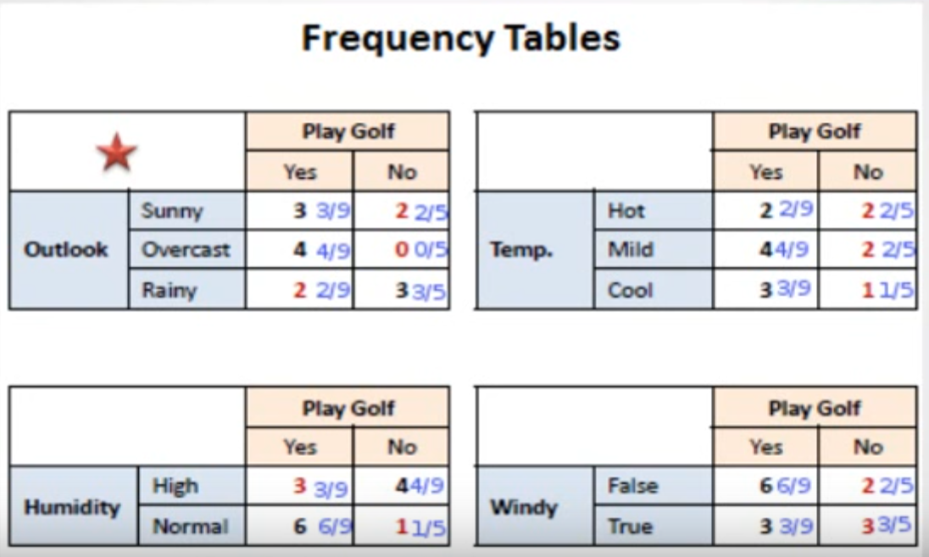
How Naïve Bayes Works

Slide 4
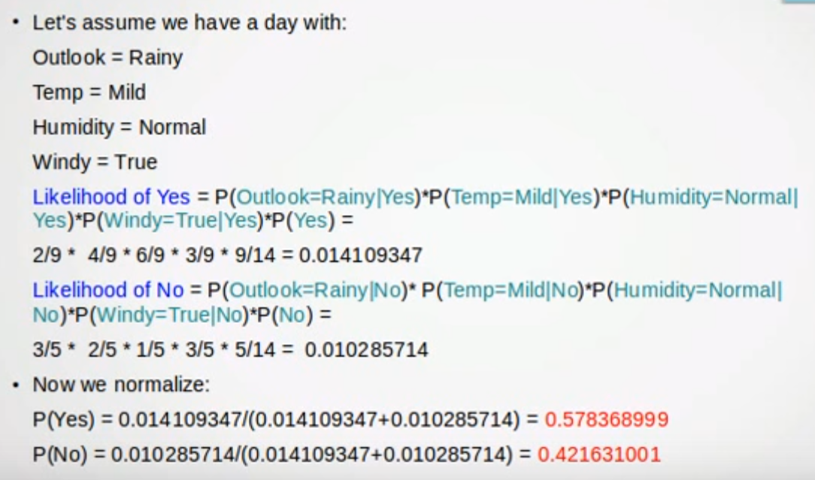
How Naïve Bayes Works

Slide 5
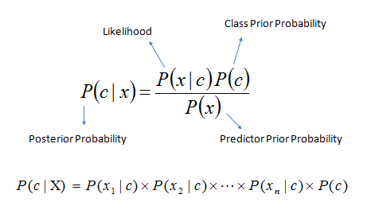
Bayes Formula

Slide 6
Our Results

Slide 7

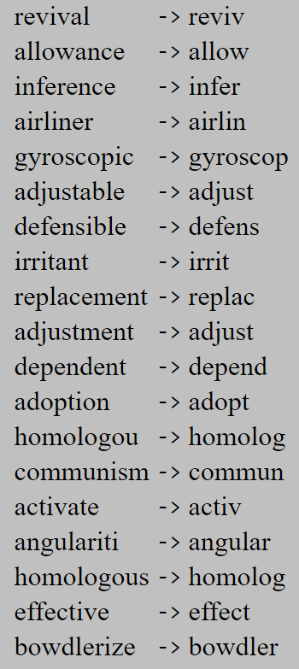
Features Added
Stemmer
Actively Learning
Critique new inputs
Add to dictionary

Slide 8
Demo

Slide 9
Sources
https://www.linkedin.com/pulse/importance-sentiment-analysis-social-media-christine-day
https://www.youtube.com/watch?v=XcwH9JGfZOU
https://www.lexalytics.com/technology/sentiment
http://snowball.tartarus.org/algorithms/porter/stemmer.html
https://inclass.kaggle.com/c/si650winter11/data

